Slide 1
Project 1
<Black Jack (21 Point)>
CSC 5 - 48102
Name:Weikang Du
Date: 10/28/16

Slide 2
Menu
Introduction
Summary
Flowchart
Declaration main variables
Pseudo Code
Sample I/O
Program

Slide 3
Introduction
Title : Black Jack ( 21 Point )
Actually, I changed some rule of this game:
There are 52 cards, and each round has 4 times to send card, each time for 1 card.
I made the game to Player vs. Computer. There are two mode for player:
1. Normal Player: Player is able to know how many points in hand, but he/she
could not know the next card number, therefore, this mode is hard one and
player want to get closer 21 but not exceeds 21 as possible.
2. Super Player: Player also can know how many points in hand, and he/she
has power to see the number of next card and decide to choose or deny.
Back to Menu

Slide 4
Summary
Project Size: about 300 lines
The number of variables: about 16
I made it around one week, and developed it one week.
It was hard to make the partial of computer, therefore,
the computer can predict whether it will exceed 21. So
the computer will never exceed 21, however, the player
can not predict that.
And also, I used some array I learned from internet and book.
Back to Menu

Slide 5
Flowchart
Using Cliffy
Click for Flowchart
Back to Menu

Slide 6
SetIcon | Describtion
card[13]={4,4,4,4,4,4,4,4,4,4,4,4,4} | There are 13 kinds of card and each kind for 4, so total card number is 52.
computerCount | The number of times the computer got the card
playerCount | The number of times the player got the card
rounds | The counter for round
cardIndex | Determine the each kind of card
flag | Make sure whether card is empty
sum_computer | The total points in hand of computer
sum_player | The total points in hand of player
tmd_card | Temporary card random number
choice | Choose card or Deny
role | The game mode
Back to Menu

Slide 7
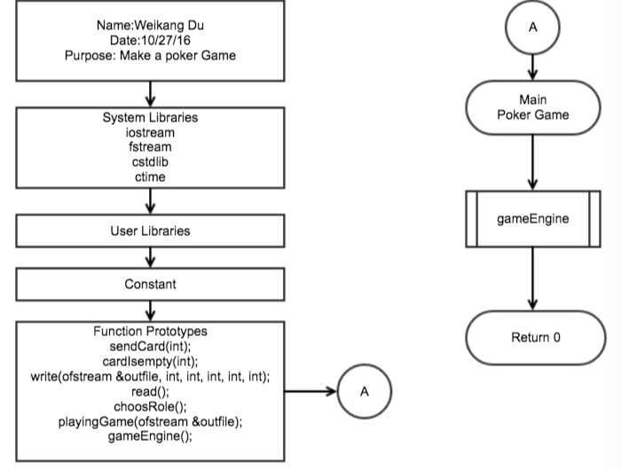
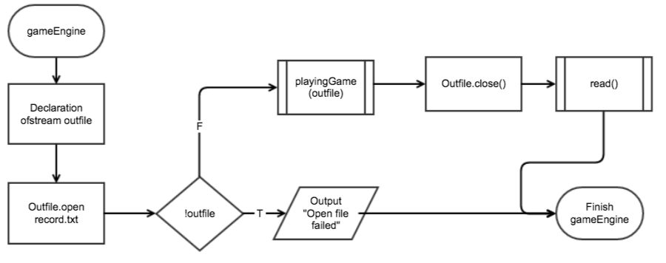
Pseudo Code
Opening comments
All using system Libraries
then, set the function prototypes
enter main
function(gameEngine)
exit the program return 0
gameEngine function
Declaration the variable
open the file ‘record.txt’ for output
verify open success or not
if not then finish the function
otherwise, function playingGame
then close the file
and read the file again for output
then finish the function

Slide 8
playingGame
Declaration the variables
set the ‘role’ get from function choosRole
set the seed for random
use while loop check function cardIsempty true of false
use while lop limit the card counter
then send computer card
computer can cheat for determine voiding exceed maximum
if not exceed maximum then add this number to computer total
then send player card
if role is super then ask user that look the card number or not
if does, then output the card number
and then ask want the card or not
if dose, then add the card number to total
card counter increment then determine by while loop above.
then increment the round number
Back to Menu

Slide 9
write function
ask the player for continue play round or not
if dose, set the prior total data to 0
if not then break the while loop for check cardIsempty
cardIsempty
set the true flag
use for loop
check each element in card array is greater then 0 or not
if does let the flag false
and break the the for loop
return this flag
ChoosRole
declaration the variable choice
out put the message and choice
get the input
verify the valid input using while loop
then switch the choice
1. set choice equal 1, break the switch
Back to Menu

Slide 10
2. set choice equal 2, break the switch
3. display the info. and menu, then input choice again
valid choice or not using while loop, break the switch
4. exit the program
while loop the switch if choice not equal 1 or 2
return choice;
sendCard
declaration the variable
use a unlimited while loop
give a random number to card between 0-12
if cards array for this element is greater than 0
the number of this element decrement
then break the while loop
and return the card number+1
write
if not open the file exit with 0
otherwise, use for loop output to file the card computer get each time
use for loop output to file card play get each time
Back to Menu

Slide 11
determine the result
use if and else if
then output to file the result
read
declaration the if stream infield
then open the file record.txt for get data
if not open then exit
otherwise, use while loop
getline the data
if ‘’ then break the while loop
otherwise display the data
then close the file
Back to Menu

Slide 12
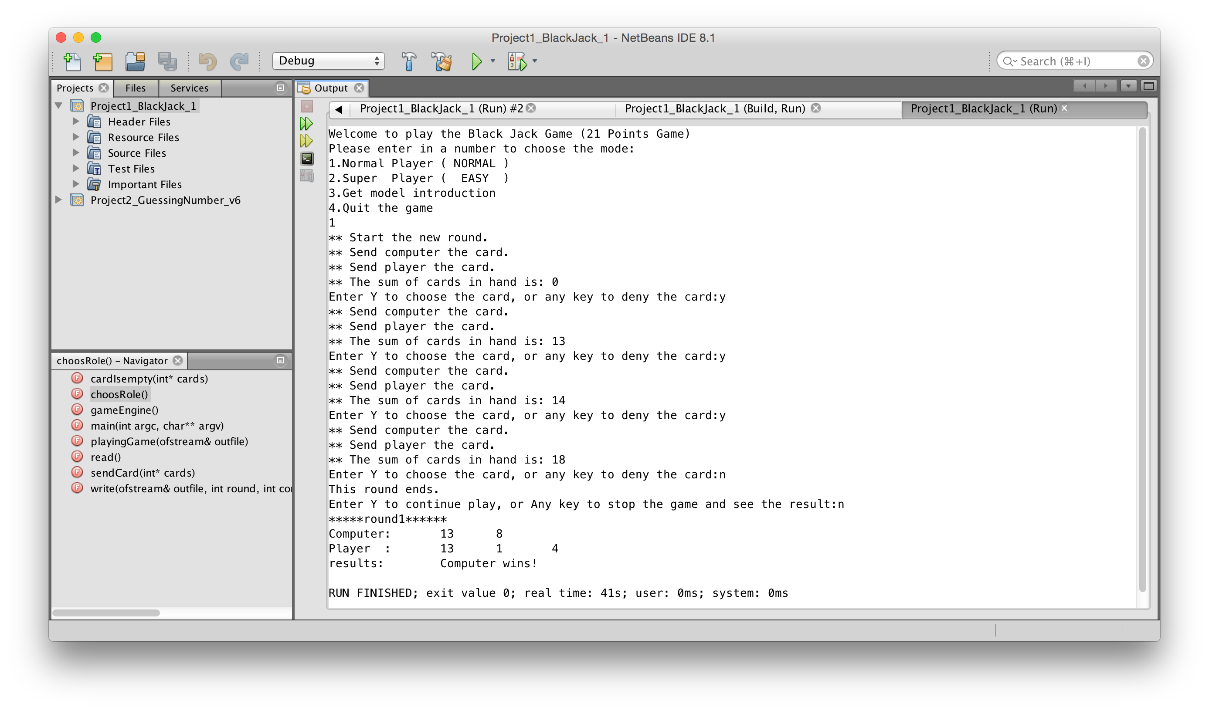
Sample I/O
Back to Menu

Slide 13
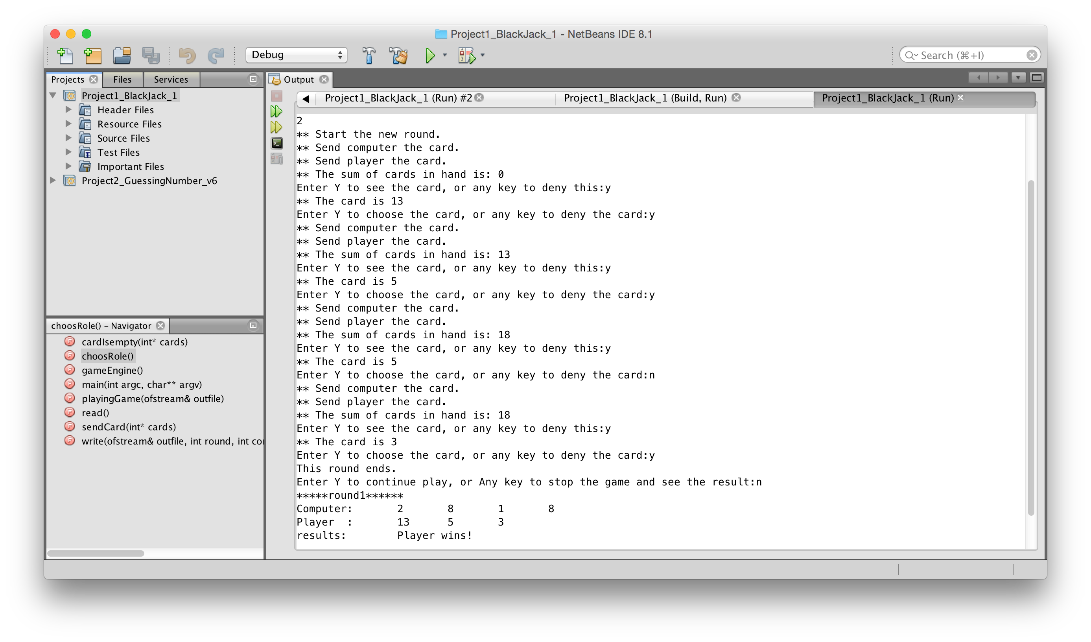
Back to Menu

Slide 14
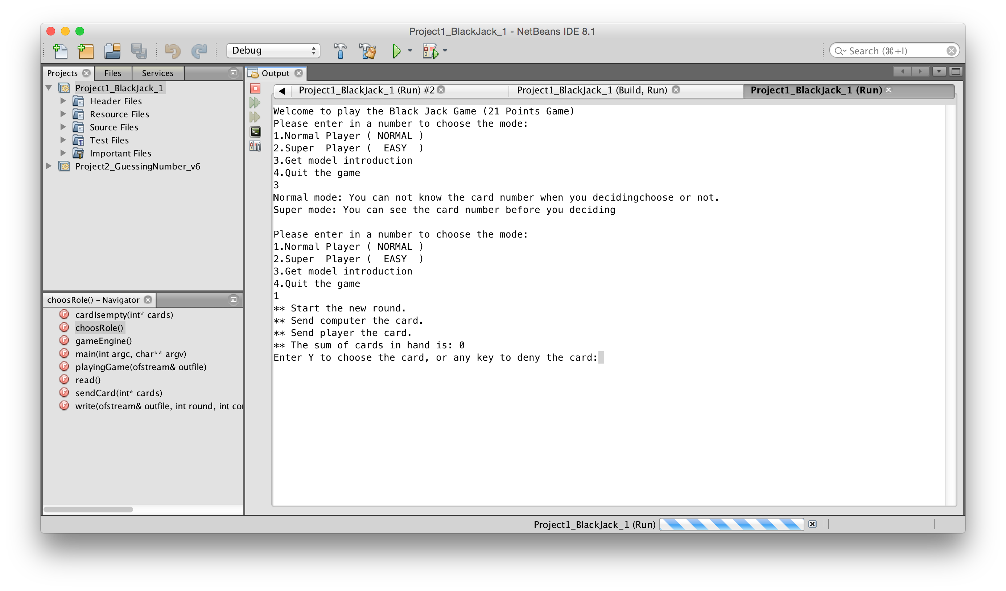
Back to Menu

Slide 15
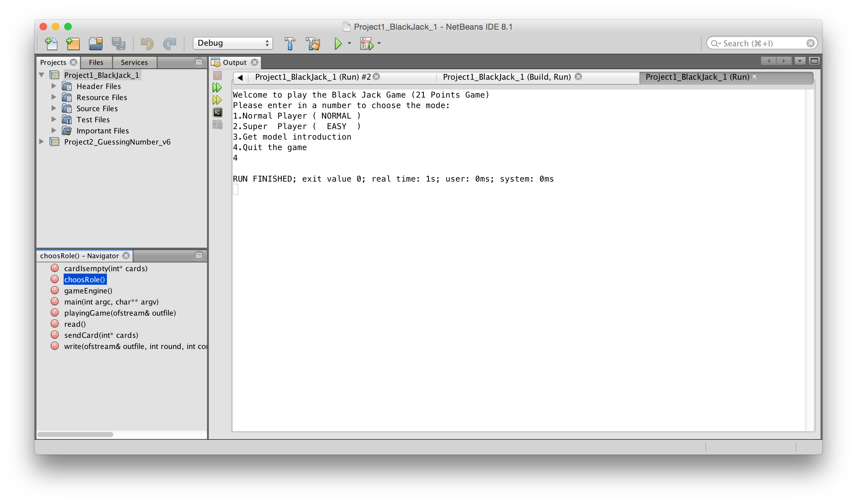
Back to Menu

Slide 16
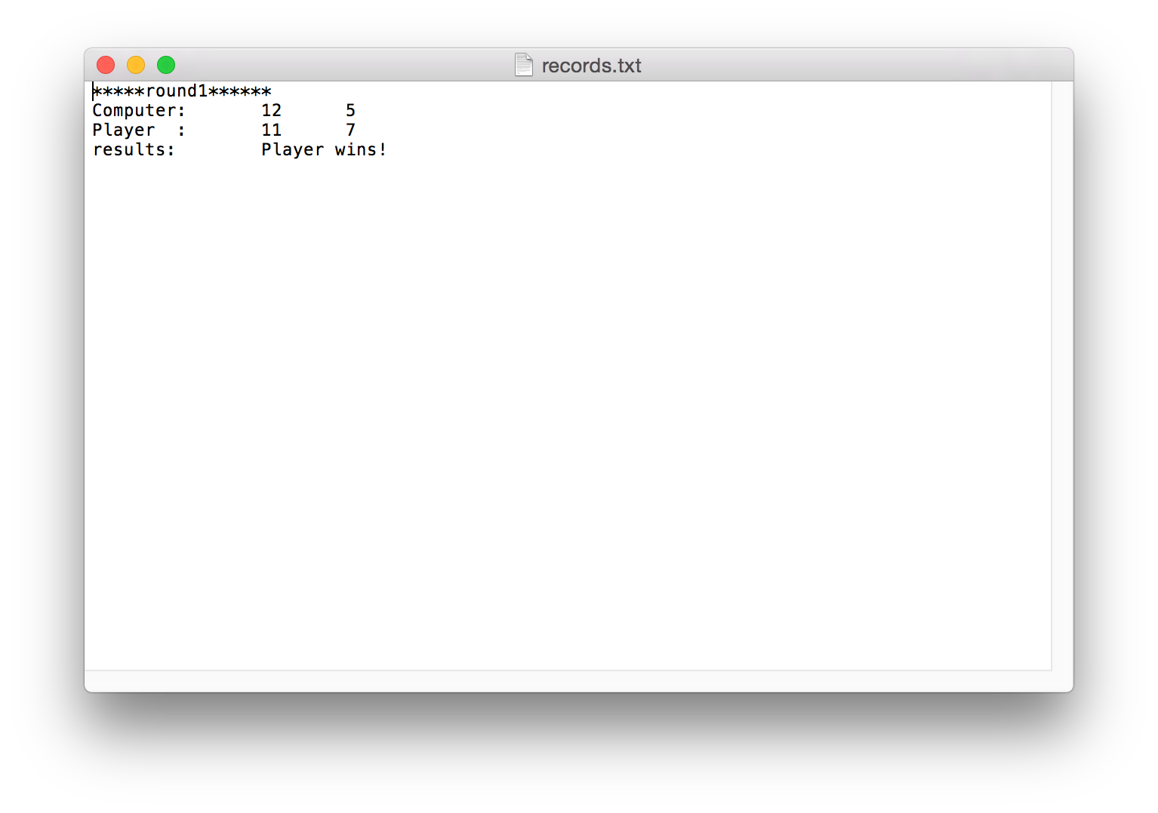

Slide 17
Program
/*
* File: main.cpp
* Author: WeikangDu
* Created on October 27, 2016, 7:07 PM
* Purpose: Make a Poker Game (Black Jack)
*/
#include<iostream> //Input and output
#include<fstream> //I/O file
#include<string>
#include<cstdlib> //For the random number
#include<ctime> //Time
using namespace std;
//User Libraries
//Global Constants
Back to Menu

Slide 18
//Function Prototypes
int sendCard(int);
bool cardIsempty(int);
void write(ofstream &outfile, int, int, int, int, int);
void read();
int choosRole();
void playingGame(ofstream &outfile);
void gameEngine();
//**************************************************************
// Main function here!! *
//**************************************************************
int main(int argc, char** argv)
{
gameEngine();
return 0;
}
Back to Menu

Slide 19
//**************************************************************
// Definition of function sendCard *
// This function limit the number and kind of card *
//**************************************************************
int sendCard(int *cards)
{
int cardIndex;
while (true)
{
//Produce a random number
cardIndex = rand() % 13;
//Determine whether the same point card exits
if (cards[cardIndex]>0)
{
cards[cardIndex]--;
break;
}
}
return (cardIndex + 1);
}
Back to Menu

Slide 20
//******************************************************************
// Definition of function cardIsempty *
// This function determine whether here is no card for total *
// and the each kind of card *
//******************************************************************
bool cardIsempty(int *cards)
{
bool flag=true;
for (int i=0; i<13; i++)
{
if (cards[i]>0)
{
flag=false;
break;
}
}
return flag;
}
Back to Menu

Slide 21
//**************************************************************
// Definition of function write *
// This function Output the result and data to a file, *
// and determine the winner *
//**************************************************************
void write(ofstream &outfile, int round,int computerCount,int *computer,int playerCount,int *player)
{
if (!outfile)
{
cout<<"Open file failed!"<<endl;
}
else
{
int sum_computer=0;
int sum_player=0;
//Output the round number
outfile<<"*****round"<<round<<"******\n";
outfile<<"Computer:\t";
Back to Menu

Slide 22
//Output the card number each time for computer
for (int i=0; i<computerCount; i++)
{
sum_computer+=computer[i];
outfile<<computer[i]<<"\t";
}
outfile<<"\n";
outfile<<"Player :\t";
//Output the card number each time for player
for (int i=0; i<playerCount; i++)
{
sum_player+=player[i];
outfile<<player[i]<<"\t";
}
outfile<<"\n";
outfile<<"results:\t";
Back to Menu

Slide 23
//Determine the result and display it
if (sum_computer>21 && sum_player>21)
{
outfile<<"Computer and Player are both explode!\n";
}
else if (sum_computer<=21 && sum_player>21)
{
outfile<<"Computer wins!\n";
}
else if (sum_computer>21 && sum_player<=21)
{
outfile<<"Player wins!\n";
}
else if (sum_computer<sum_player)
{
outfile<<"Player wins!\n";
}
else if (sum_computer>sum_player)
{
outfile<<"Computer wins!\n";
}
else if (sum_computer==sum_player){
outfile<<"No one wins!\n";
}
}
}
Back to Menu

Slide 24
//**************************************************************
// Definition of function read *
// This function read the data from the file *
//**************************************************************
void read()
{
ifstream infile;
infile.open("records.txt");
if (!infile)
{
cout<<"Open file failed!"<<endl;
}
else
{
string str;
while(!infile.eof())
{
getline(infile, str);
if(str=="")
{
break;
}
Back to Menu

Slide 25
else
{
cout<<str<<endl;
}
}
infile.close();
}
}
//**************************************************************
// Definition of function choosRole *
// This function show the menu and return a mode *
//**************************************************************
int choosRole()
{
int choice;
//Display the menu
cout<<"Welcome to play the Black Jack Game (21 Points Game)"<<endl;
cout<<"Please enter in a number to choose the mode:"<<endl;
cout<<"1.Normal Player ( NORMAL )"<<endl;
cout<<"2.Super Player ( EASY )"<<endl;
cin>>choice;
return choice;
}
Back to Menu

Slide 26
//************************************************************************
// Definition of function playingGame *
// This function send the card to computer and player, *
// and determine whether choose or not the card for each time *
//************************************************************************
void playingGame(ofstream &outfile)
{
int tmp_card; //Temporary card number
char choice;
int card_count=0; //The times of send card
int sum_computer,sum_player; //The total number in hand for both
int role; //chose the mode
//Declaration the Variables
int cards[13]={ 4,4,4,4,4,4,4,4,4,4,4,4,4}; //The 13 kinds of poker and each for 4, no joker
int computer[24];
int computerCount=0; //The number of computer get card
int player[24];
int playerCount=0; //The number of player get card
int rounds=0; //Set the round
Back to Menu

Slide 27
role=choosRole();
cout<<"** Start the new round."<<endl;
srand((unsigned)time(NULL)); //Set the seed for the random number
while (!cardIsempty(cards)) //Call the cardIsempty function
{
card_count=0;
sum_computer=0;
sum_player=0;
while (card_count<4)
{
cout << "** Send computer the card.\n";
tmp_card=sendCard(cards); //Call the sendCard function
if (sum_computer+tmp_card<=21)
{
sum_computer+=tmp_card; //Call the sendCard function
computer[computerCount]=tmp_card;
computerCount++;
}
Back to Menu

Slide 28
cout<<"** Send player the card.\n";
tmp_card=sendCard(cards); //Call the sendCard function
cout<<"** The sum of cards in hand is: "<<sum_player<<endl;
if(role==2) //mode 2 super player
{
cout<<"Enter Y to see the card, or any key to deny this:";
cin>>choice;
if(choice=='Y'||choice=='y')
{
cout<<"** The card is "<<tmp_card<<endl;
}
}
cout << "Enter Y to choose the card, or any key to deny the card:";
cin >> choice;
if (choice=='Y'||choice=='y')
{
sum_player+=tmp_card;
player[playerCount]=tmp_card;
playerCount++;
}
card_count++;
}
Back to Menu

Slide 29
rounds++;
write(outfile,rounds,computerCount,computer,playerCount,player);
cout << "This round ends."<<endl;
cout << "Enter Y to continue play, or Any key to stop the game and see the result:";
cin >> choice;
if (choice=='Y'||choice=='y')
{
computerCount=0;
playerCount=0;
for(int j=0; j<24; j++)
{
computer[j]=0;
player[j]=0;
}
for(int j=0; j<13; j++)
{
cards[j]=4;
card_count=0;
continue;
}
}
Back to Menu

Slide 30
{
break;
}
}
}
//**************************************************************
// Definition of function gameEngine *
//**************************************************************
void gameEngine()
{
ofstream outfile;
outfile.open("records.txt");
if (!outfile)
{
cout<<"Open file failed!"<<endl;
}
else
{
playingGame(outfile);
outfile.close();
read();
}
}
Back to Menu

